Slide 1
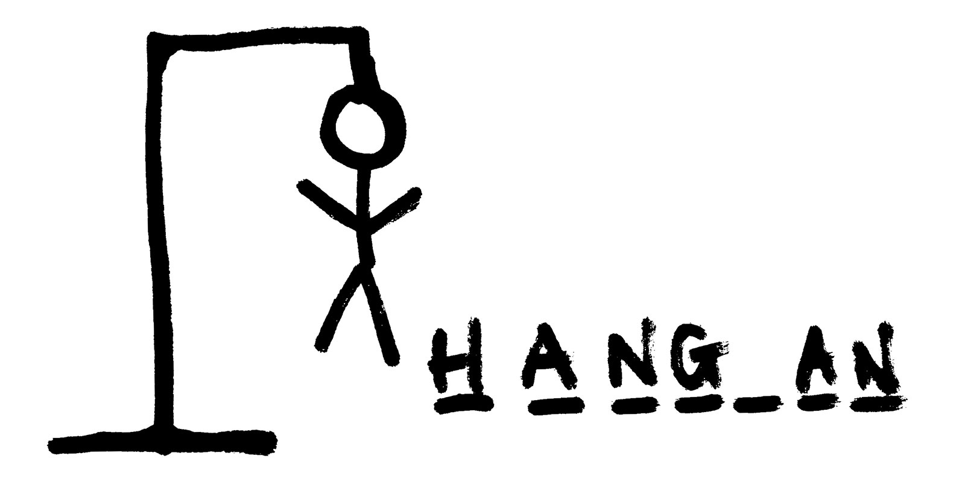
The Hangman Game
Coder: Baltazar Juarez
Using: AtanWood’s Repository
The classic word game, you have 7 attempts to guess the word.
Good luck!

